Slide 1
CSC 102
Flowcharts and Algorithms
Chinenye Ajah
Thursday 31st March 2022

Slide 2
Project 1
STEP 1:START
STEP 2:SET Aminat at (0,0) East
STEP3: MOVE Amina to (3,0)
STEP 4:Is there a flower at (3,0)?
YES:DROP flower at (3,2)
NO: Go to step 6
STEP 5: MOVE one space East
STEP 6:STOP

Slide 3
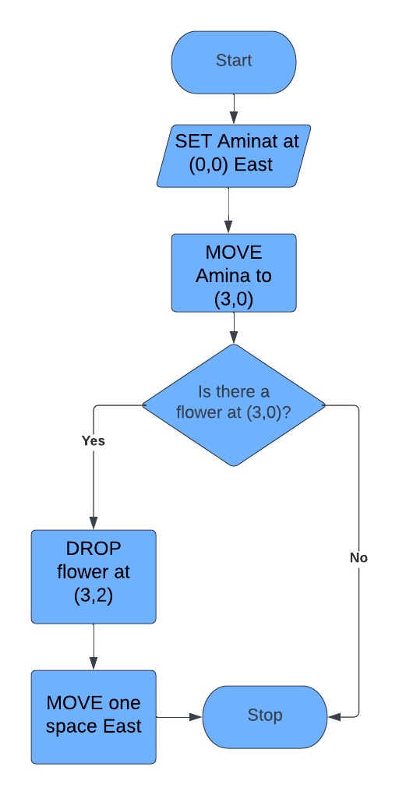
Project 1

Slide 4
Project 2
STEP 1: START
STEP 2: STORED DATA x= Employee List
STEP 3: INPUT Name in required slot
STEP 4: Is Name in Employee List?
YES: OUTPUT You are an employee welcome
NO: OUTPUT You are not an employee of this organisation
STEP 5:Stop

Slide 5
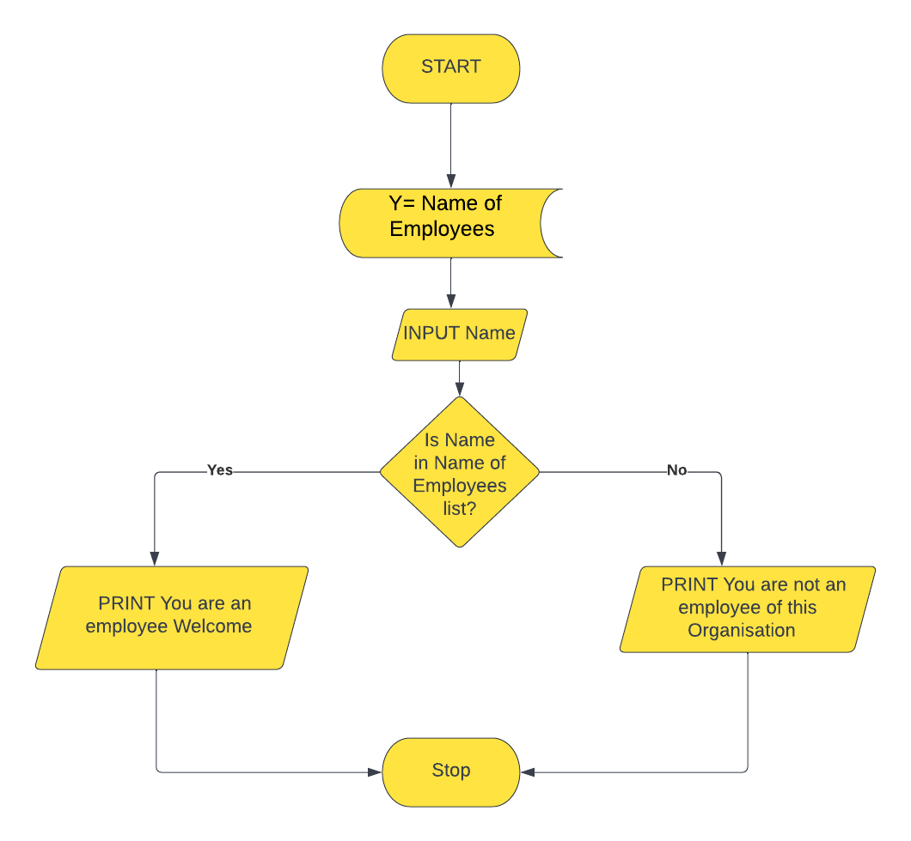
Project 2

Slide 6
Project 3
STEP 1: Start
STEP 2: INPUT Location
STEP 3: IF location of delivery is Epe
STEP 4: INPUT weight of package
STEP 5 : IF weight of package is greater than or equal to 10kg print total cost is N5000
STEP 6: ELSE display N4000
STEP 7: : IF location of delivery is PAU
STEP 8: INPUT weight of package
STEP 9 : IF weight of package is greater than or equal to 10kg print total cost is N2000
STEP 10: ELSE display N1500
STEP 11: STOP

Slide 7
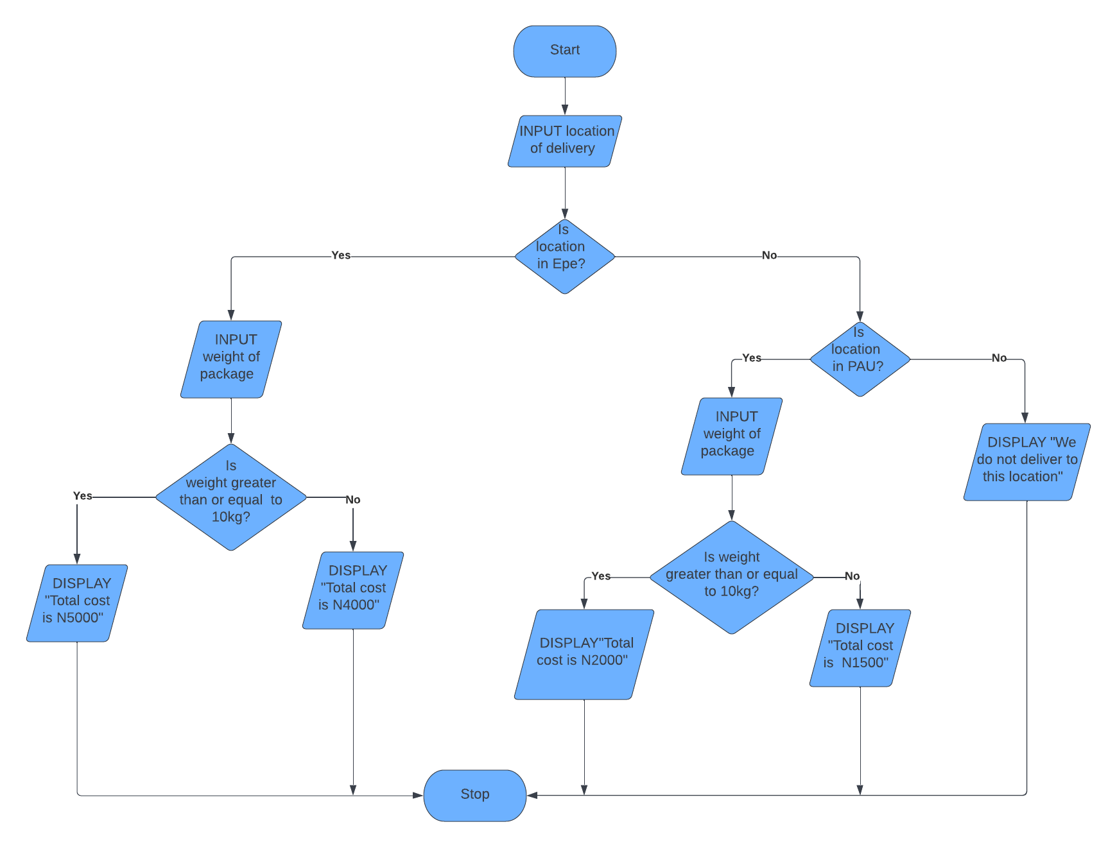
Project 3

Slide 8
Project 4
STEP1: Start
STEP 2: INPUT Jamb score
STEP 3: IF Jamb score is greater than or equal to 230
STEP 4: INPUT number of credits or higher in 5 key subjects
STEP 5:ELSE Print You have not been granted admission into computer science
STEP 6: IF number of credits is more than or equal to 5
STEP 7: INPUT if the interview was passed or failed
STEP 8:ELSE Print You have not been granted admission into computer science
STEP 9: IF Interview was passed
STEP 10: PRINT You have been granted admission into computer science
STEP 11: You have not been granted admission into computer science
STEP 12: Stop

Slide 9
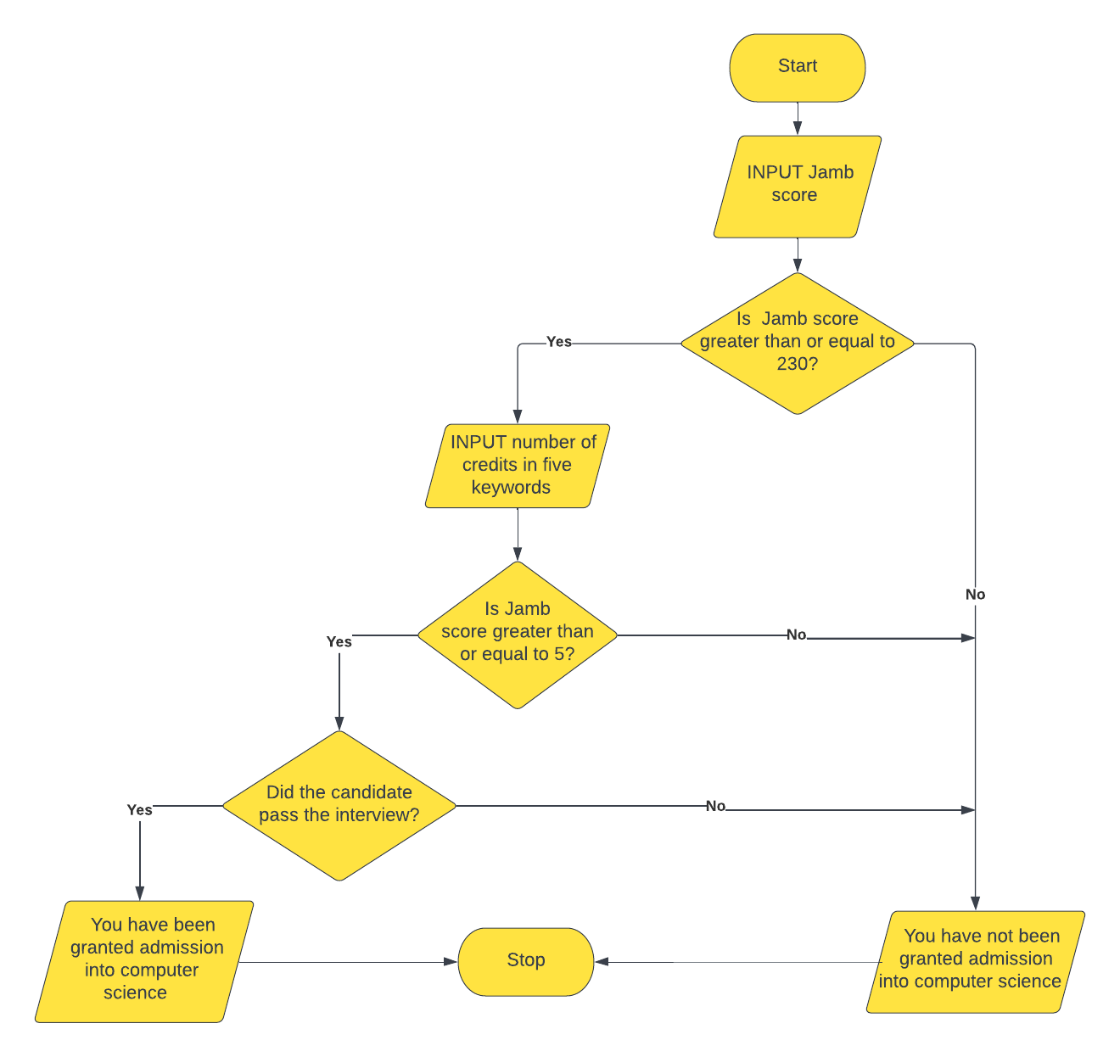
Project 4

Slide 10
Project 5
STEP 1: Start
STEP 2: SET boy at (0,0) facing East with flower
STEP 3:SET girl at (0,2) facing west
STEP 4: SET flower vase at (3,2)
STEP 5: MOVE boy with flower to (0,2)
STEP 6: GIVE flower to girl
STEP 7:SET girl to East
STEP 8: Move girl to (3,2)
STEP 9: DROP flower into vase
STEP 10: MOVE girl to (3,4)
STEP 11: STOP

Slide 11
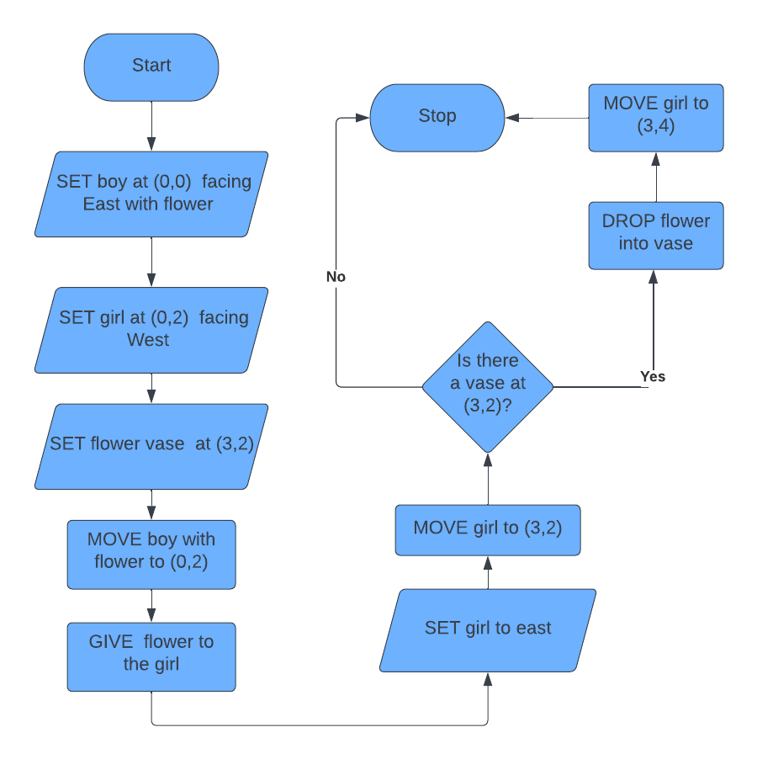
Project 5

